Slide 1




Ghislain Auguste ATEMEZING 2nd Year PhD Candidate
Publishing and Consuming Government Linked Data on the Semantic Web
Multimedia Semantics Group
Supervisor: Raphaël TRONCY
Notes:
Hello, I’m Ghislain, working under the supervision of Raphaël in the Multimedia Semantics Group. My research investigates current issues on lifting raw government data and public sector information into 5 stars semantic data as well as the development of novel techniques for visualizing this rich semantics data.

Slide 2

The Big Picture
Many datasets are released as Open Data
With the Open Data Initiative (since 2010)
In France, data.gouv.fr (National) / opendatafrance.net (Regional)
Heterogeneity of data formats and access methods
KML, SHP, PDF, XLS, etc. / API, files, database, etc.
Raising issues when re-using the data:
Meaning of the data w.r.t context
Interoperability
One API for each application
… all floating around a single canal: the Web!
Flickr:developmentseed/6328687633

Slide 3
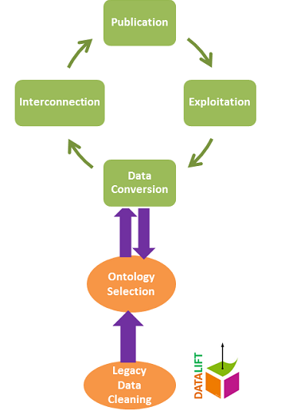
Our Research Problems
Publishing structured data on the Web
From proprietary formats to structured data
Resource identification policies
Knowledge discovering strategy
Consuming data by Innovative Apps
Ease the development of dataviz
Facilitate interoperable web applications
But we need some guidelines and tools
For defining vocabularies and reusing others
For naming “Things”
For linking datasets
For creating innovative applications

Slide 4
Our Contributions So Far …
A vocabulary for describing Features and Point Of Interest for the French territory
Providing alignments to other geo-related
Providing solutions to bridge “semantic-gap” of INSPIRE datasets
Building two prototype applications using our Linked Data publishing life-cycle
Propose a novel approach towards interoperable web applications
Prototype for detecting relevant patterns to ease the implementation of web applications
Contributions at W3C Government Linked Data WG
Community Directory, Glossary, Best Practices Document

Slide 5
Ghislain Auguste ATEMEZING 2nd Year PhD Candidate.
Publishing and Consuming Government Linked Data on the Semantic Web
Multimedia Semantics Group
Supervisor: Raphaël TRONCY

